Slide 1
“
Multi-Task LearniNg for dravidian languages

Slide 2

Team members:
ANMOL KUMAR (19BCS011)
BIPUL GAUTAM (19BCS023)
SEJAL RAI (19BCS098)
AMAN KUMAR (19BCS115)
Supervised by:
DR. SUNIL SAUMYA

Slide 3
Problem staTEMENT
The goal of this project is to perform Sentiment Analysis and identify offensiveness in code-mixed social media comments (youtube) for Dravidian languages (Kannada, Malayalam and Tamil).

Slide 4

mOTIVATION
This project works on code-mixed social-media comments for Kannada language.
There are plenty of hate and offensive comments on social media and across the internet in different languages.
An appreciable amount of work has been done in mainstream languages like English to curb the threat. Companies like Google, Facebook, Amazon are doing a lot for major languages like English.
The selection of these tasks is motivated by the lack of large labelled data for user-generated code mixed datasets . Our framework is applicable to other sequence classification problems irrespective of the size of the datasets . Experiments show that our multi-task learning model can achieve high results compared with single task learning while reducing the time and space constraints required totrain the models on individual tasks . For the tasks of sentiment analysis and offensive language identification, the best-performing modelscored a weighted F1-score of (66.8\% and 90.5\%), (59\%. and 70\%), and (62.1\%and 75.3\%) for Kannadas on sentiment analysis and offensivelanguage identification, respectively . The data and approachesdiscussed in this paper are published in Github\footnote.com/Dravidian-MTL-Benchmarking. The data is published inGithub\Footnote\footnotes: http://://https://://://

Slide 5
mOTIVATION
Not much work has been done in the Dravidian languages, e.g, Kannada, Tamil, Malayalam, etc.
The population of Karnataka is almost equal to the population of entire France. Yet not much work has been done in the Dravidian languages.
This is a matter of concern as internet has penetrated to the distant lands and with affordable rates, everyone is able to get it, so there is a large chunk of people using the social media.
The offensive and hateful comments are also the reason of violent acts, e.g, riots.
So, curbing them is a necessity.

Slide 6
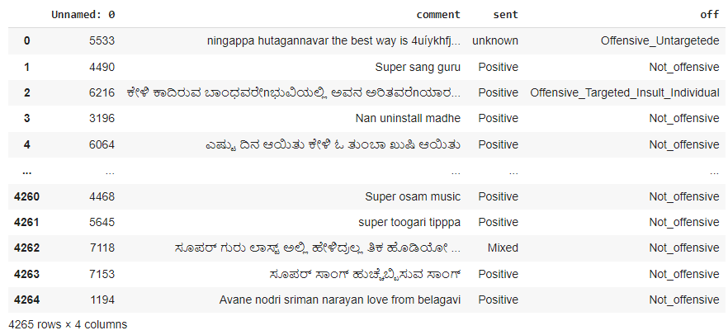
DATASET
Kannada dataset:

Slide 7
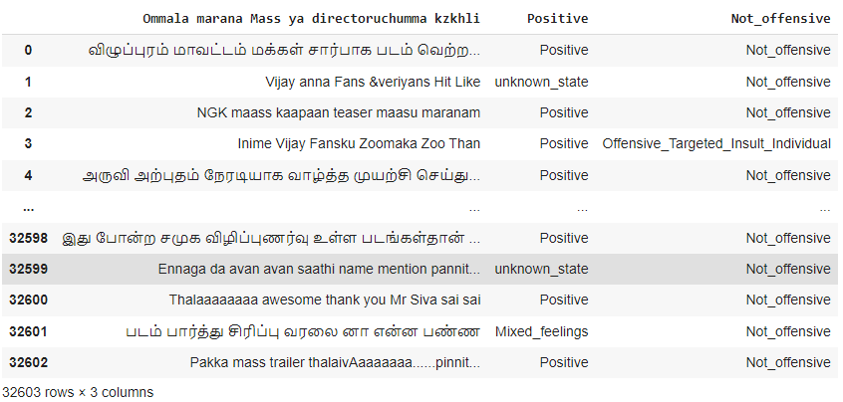
DATASET
Tamil dataset:

Slide 8
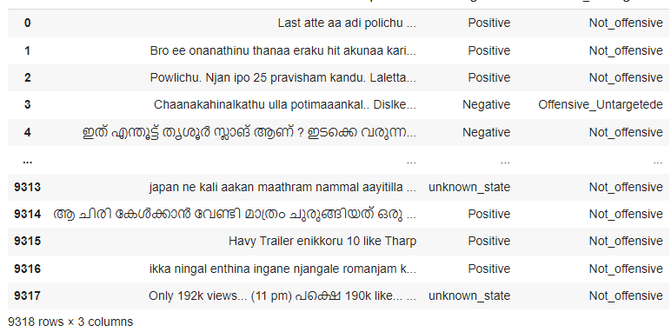
DATASET
Malayalam dataset:

Slide 9
Dataset
About the Kannada dataset:
Our dataset contains 5 columns and 4265 rows.
The feature is “comment” and the labels are “sent” and “off”.
The feature column contains the comments primarily in Kannada, but is mixed with other languages such as, English, Turkish, etc.
The “sent” label consists of 4 values: Unknown, Positive, Negative and Mixed.
The ‘’off” label consists of 5 values:
Offensive_Untargeted, Not_offensive, Offensive_Targeted_Insult_Individual, Offensive_Targeted_Insult_Other, Offensive_Targeted_Insult_Group.

Slide 10
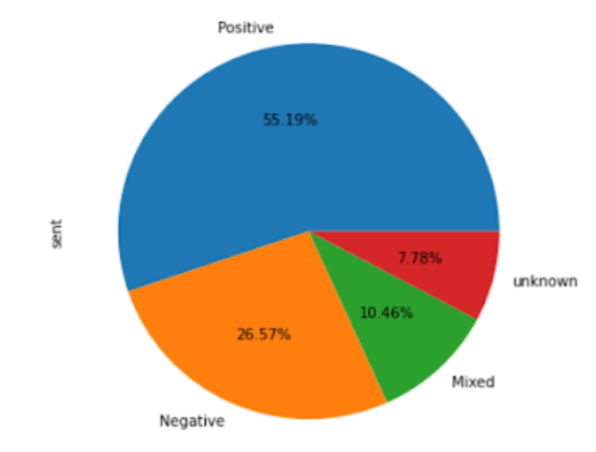
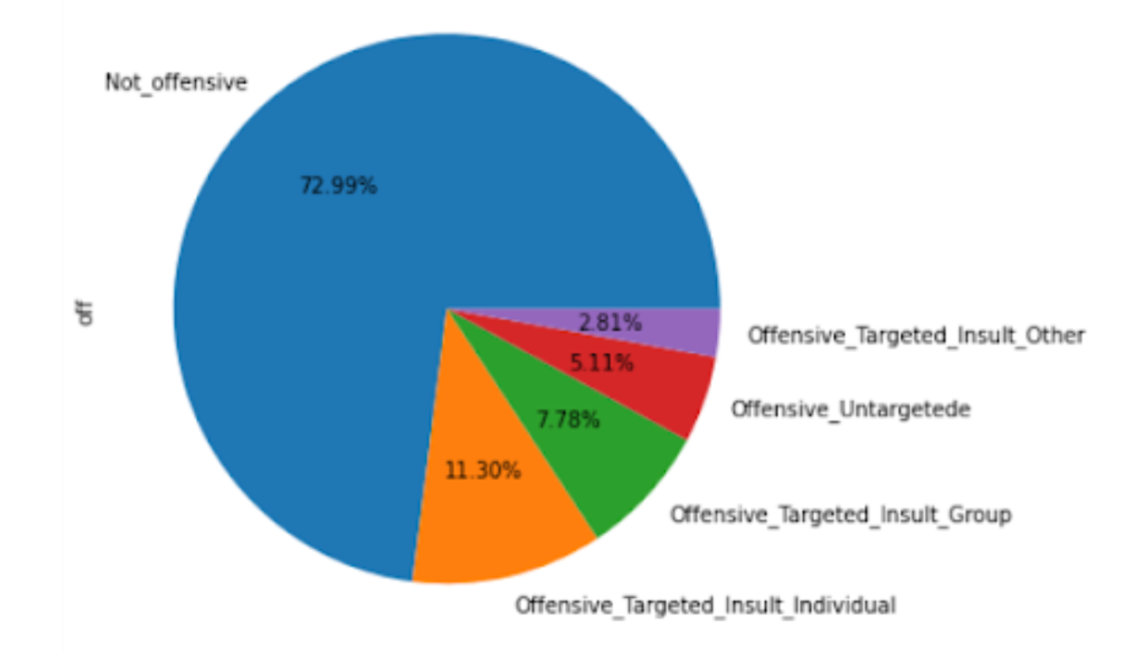
DATASET- PICTORIAL Representation

Slide 11
Libraries for indic languages
There are 3 python libraries available to us for text processing when it comes to Indic Languages:
iNLTK- Hindi, Punjabi, Sanskrit, Gujarati, Kannada, Malyalam, Nepali, Odia, Marathi, Bengali, Tamil, Urdu
Indic NLP Library- Assamese, Sindhi, Sinhala, Sanskrit, Konkani, Kannada, Telugu,
Stanford NLP- Many of the above languages
In this project, we have used iNLTK package

Slide 12
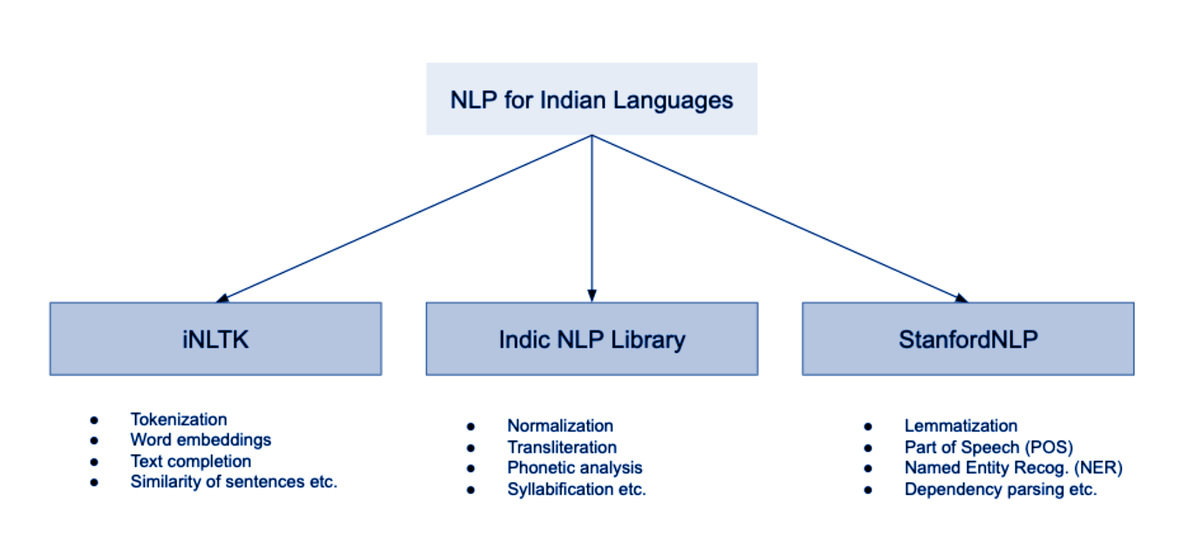
Libraries for indic languages

Slide 13
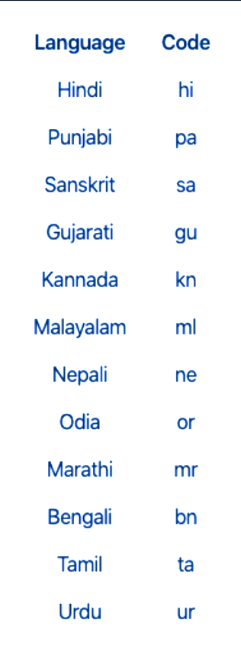
iNLtk
About Natural Language Toolkit for Indic Languages:
The iNLTK¹ library is the Indian language equivalent of the popular NLTK Python package.
iNLTK provides most of the features that modern NLP tasks require, like generating a vector embedding for input text, tokenization, sentence similarity etc. in a very intuitive and easy API interface.
We have used iNLTK in this project for text-processing, tokenization, extract embedding vectors,.
iNLTK currently supports 12 languages of the Indian Subcontinent.

Slide 14
workFLOW
Translation of dataset to pure Kannada
Tokenization was performed
Removed the Kannada stopwords
Prediction
SVM Model was created
Embedding using iNLTK was done

Slide 15
WORKFLOW
1. Translation of dataset to pure Kannada
Our dataset consists of Kannada mixed with other languages such as, English, Turkish, etc.
So for our model, to proceed ahead it was needed to convert to pure Kannada language.
To fulfill the above requirement, we have used “googletrans” package and “GOOGLETRANSLATE” service utility in MS Excel.
=GOOGLETRANSLATE(cell with text, “source language”, “target language”)

Slide 16

WORKFLOW
2. Performing Tokenization
Tokenization is a way of separating a piece of text into smaller units called tokens. The tokens can be either words, characters, or subwords.
It is first step of NLP pipeline.
Using iNLTK, we have tokenized the separate comments into words.

Slide 17
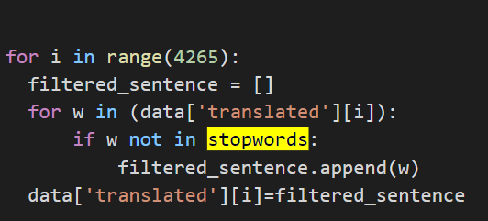
WORKFLOW
3. Removing the Kannada Stopwords
We collected the list of Kannada stopwords from the internet and then we removed the matching stopwords from our translated dataset using iNLTK.

Slide 18
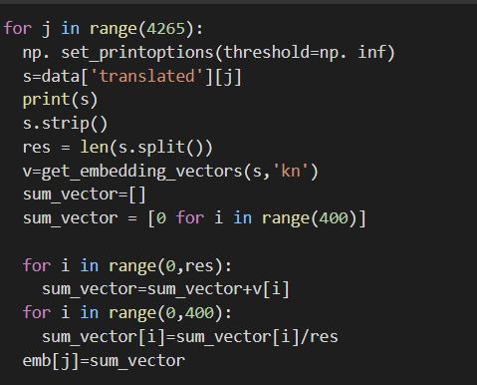
WORKFLOW
4. Embedding
a. Using iNLTK
Using iNLTK¹, we have generated the embedding vectors and we have stored it in an np_array of size 4265 X 400.
Here, for each comment using iNLTK, we have got vectors of 400 size.
Then, we have stored embeddings in a .npy file for further use.

Slide 19
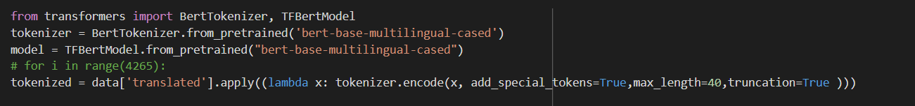
WORKFLOW
4. Embedding
b. Using mBert
Using mBert² and providing padding, we have generated the embedding vectors and we have stored it in an np_array of size 4265 X 768.
Here, for each comment using mBert, we have got vectors of 768 size.
Then, we have stored embeddings in a .npy file for further use.

Slide 20
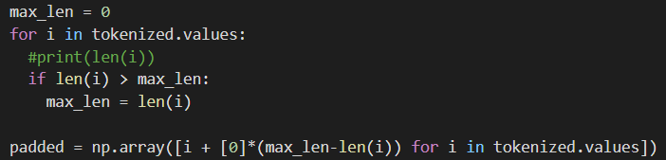
WORKFLOW
4. Embedding
b. Using mBert

Slide 21
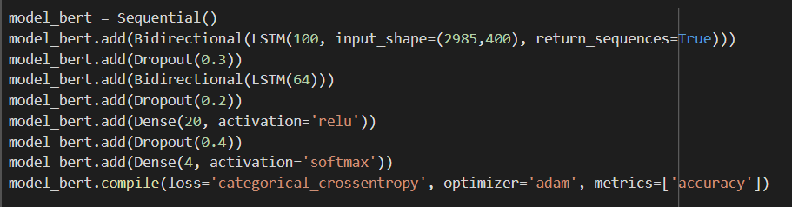
WORKFLOW
5. Creating the Model
a. BiLSTM Model with iNLTK embedding
We have created BiLSTM³ model using iNLTK embeddings
Accuracy: 55%

Slide 22
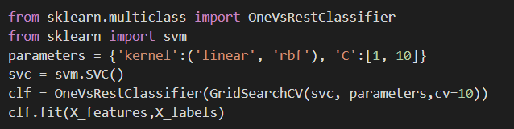
WORKFLOW
5. Creating the Model
b. SVM Model with iNLTK embeddings
We have created SVM model using OneVsRestClassifier from sklearn.multiclass package.
Here, we are comparing each class with other class and predicting the accuracy.
Accuracy of Model 1: 55%, Accuracy of Model 2: 65%

Slide 23
WORKFLOW
5. Creating the Model
c. SVM Model with mBert embeddings
We have created SVM⁴ model using OneVsRestClassifier from sklearn.multiclass package.
Here, we are comparing each class with other class and predicting the accuracy using mBert.
Accuracy: - Model 1: 53% and Model 2: 53%

Slide 24
WORKFLOW
5. Creating the Model
d. Random Forest Classifier with mBert embeddings
We have created Random Forest Classifier⁵ using RandomForestClassifier from sklearn.ensemble
Here, we are using 50 n_estimators to classify.
Accuracy: 45.5%

Slide 25

WORKFLOW
6. Prediction and Accuracy
After creation of the model, we performed prediction over the test data.
We got an accuracy of 51.7% for model 1 and 65.9% for model 2.

Slide 26
Problem faced and solutions
Our dataset was not primarily only in Kannada but mixed.
So we translated the comments to Kannada.
While using the Google Trans API to translate the comments into Kannada, there was a limit to how many translations the API endpoint could make.
So the entire dataset was not getting translated. We used MS Excel to overcome this problem using the formula.
While getting the embeddings using iNLTK, the RAM was getting exhausted.
So we divided the dataset into batches of 250 data points and ran it for 20 times to get the embeddings. Simultaneously, we stored the embeddings in the dataset.

Slide 27
Problem faced and solutions
While extracting the embedding we were unable to do it because embeddings were saved in string format.
We saved in a numpy array and stored it in .npy file.
We tried to implement Bi-LSTM model, due to inconsistency of labels in the dataset, the model was classifying only one class in both the labels, i.e, sent and off.
Therefore, we tried SVM model to classify.

Slide 28
Constraint
Due to unavailability of computing resources, we could only do it for Kannada language.

Slide 29
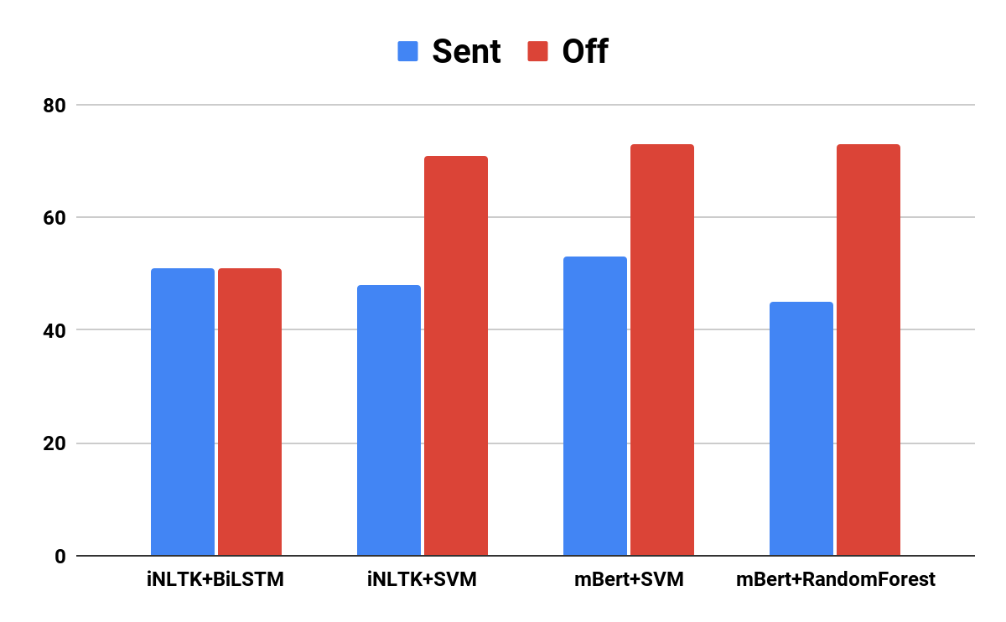
RESULT

Slide 30
result
Accuracy
 | iNLTK+bilstm | inltk+svm | mbert+SVM | Mbert+randomforest
sent | 51% | 47.8% | 52.9% | 45.4%
off | 51% | 71.4% | 72.7% | 72.6%

Slide 31
FUTURE PLANS
We will improve the consistency of the data set to improve the model performance using Augmentation.
We will be replicating the model for Tamil and Malayalam languages.
We will integrate the model into a web application.
We will also make it available as an API so that others are able to use it.

Slide 32
Conclusion
Numerous advanced methodologies and approaches for language processing tasks are examined in depth in this work.
Extensive reviews of language processing are offered, with a focus on Offensive language detection.
The building elements for numerous natural language processing tasks, such as tokenization, transliteration, embedding and so on are covered.Two types of famous embedding techniques are also covered namely embedding using INLTK and MBERT which is the crucial part of this project.
Training of these embedded vectors are performed on few of the best models in terms of accuracy like the random forest , SVM and Random forest .
We finally succeeded in building the models and predicting the outputs where in all the models gave nearby accuracy .

Slide 33
References
iNLTK Documentation: -https://inltk.readthedocs.io/en/latest/api_docs.html
m-Bert: -https://huggingface.co/bert-base-multilingual-cased
BiLSTM: -https://analyticsindiamag.com/complete-guide-to-bidirectional-lstm-with-python-codes/
SVM: -https://scikit-learn.org/stable/modules/svm.html
Random Forest Classifier: -https://www.codementor.io/@agarrahul01/multiclass-classification-using-random-forest-on-scikit-learn-library-hkk4lwawu

Slide 34
THANK YOU! 🙂

